Slide 1
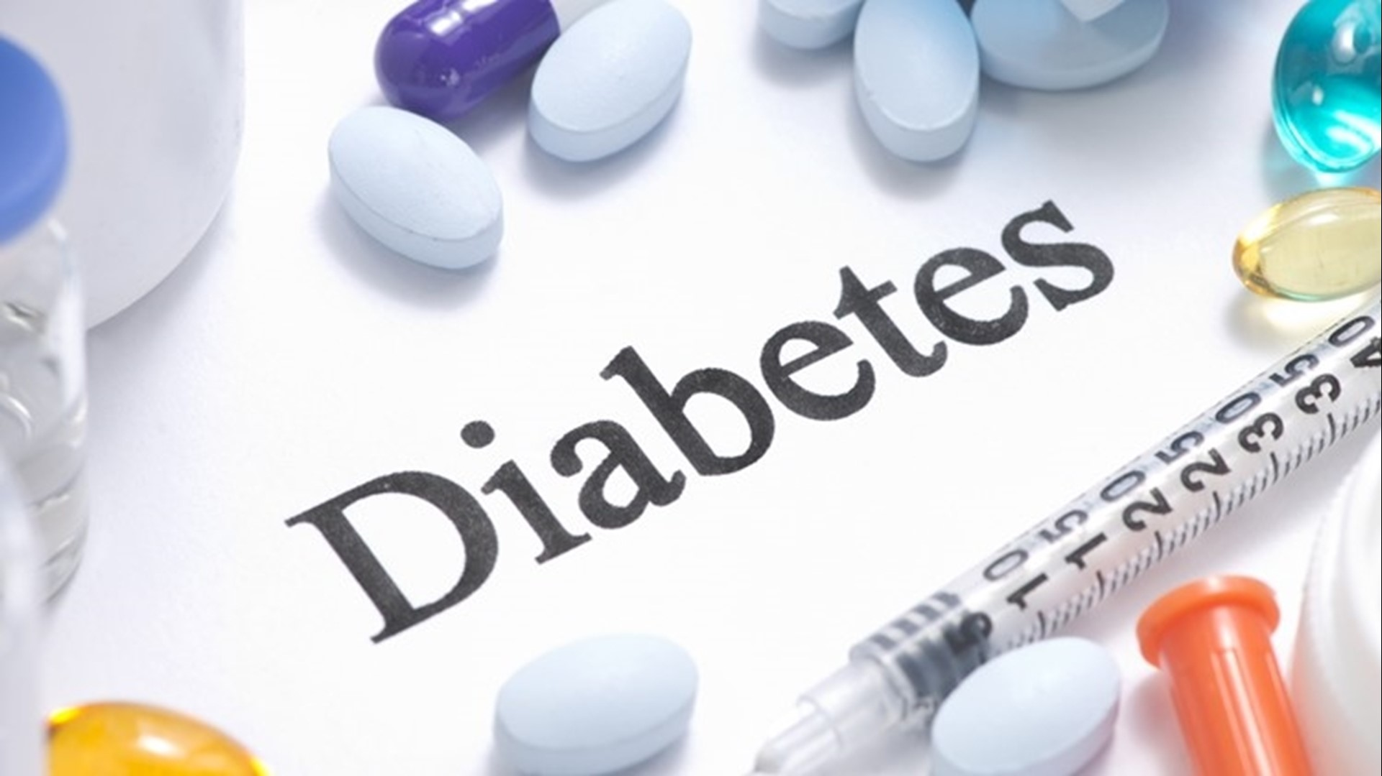
DIABETES PREDICTION USING MACHINE LEARNING
Team Members :
Swapna Sonti - 11653211
Keerthi Annem - 11656566
RajaSekhar Ponnuru - 11693961
Pavan Kalyan Ganta - 11708091

Slide 2
Goals and Objectives :
Motivation : | Significance : | Objectives : | Features :
Understanding the links between diabetes and other health problems using current methods for analyzing health data. Identifying and taking care of individuals in danger. Improving the quality of life, lowers healthcare costs and promotes healthy communities. | Using an advanced algorithm to analyze health data helps reduce the link between type 2 disease and other health problems. This makes it possible to identify individuals in danger and propose an intervention. This improves quality of life and reduces the burden on the healthcare system. | The goal is to use PySpark, Hadoop and Hive to study the impact of variables such as blood sugar, blood pressure, skin size and body mass on disease. We will develop a Machine-Learning-Modell based on atmospheric data and measure it using metrics such as F1-Score and AUC-Kurve. Additionally, we will use Hyperparameter-Tuning in order to improve the accuracy. | Pregnancies Glucose Blood Pressure Skin Thickness Insulin BMI (Body Mass Index) Age

Slide 3
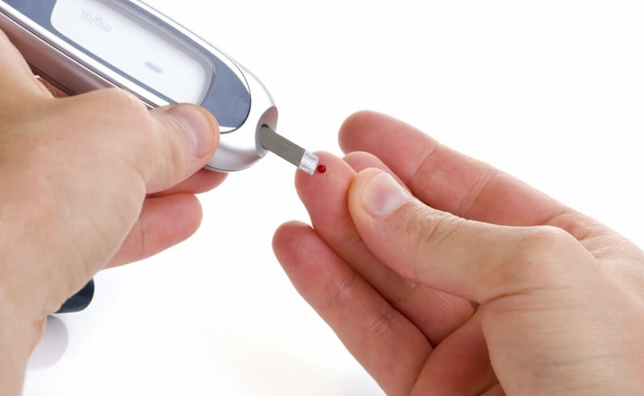
INTRODUCTION
Diabetes is a widespread disease that poses a life-threatening risk.
Diabetes can be diagnosed when the level of glucose in the bloodstream is higher than average. It is possible that this is due to an increase in insulin concentration or biological effects. Diabetes can affect our health and cause problems with our kidneys, eyes, tissues and blood vessels.
Diabetes Type 1 and Diabetes Type 2 are the two main forms of diabetes.
The majority of individuals with Type-1-Diabetes are under 30 years old. This form of diabetes cannot be cured by medication. It presents with symptoms such as increased Sed and increased frequency of urination.
Diabetes type 2 is more common in older people, who may also have obesity, high blood glucose or other conditions. Thanks to our modern society, Diabetes is more and more prevalent in our daily lives.
It is therefore impressive to obtain information on diabetes assessment methods.
This Photo by Unknown author is licensed under CC BY-SA-NC.

Slide 4
Background :
In this study, a diabetes prediction system that uses machine learning is presented, with an accuracy of 81% using the XGBoost-Klassifikator. It is based on personal data from female patients in Bangladesh. This system combines explainable artificial intelligence technologies, feature selection and class control, to create an instant forecasting system and Android application[1].
The Pima Indian Diabetes Database is used for this study. The approach focuses on participants aged 21 or over. Data Science Paketes in Python are used to prepare the data, classify it using logistic regression and store the data in joblib[2].

Slide 5
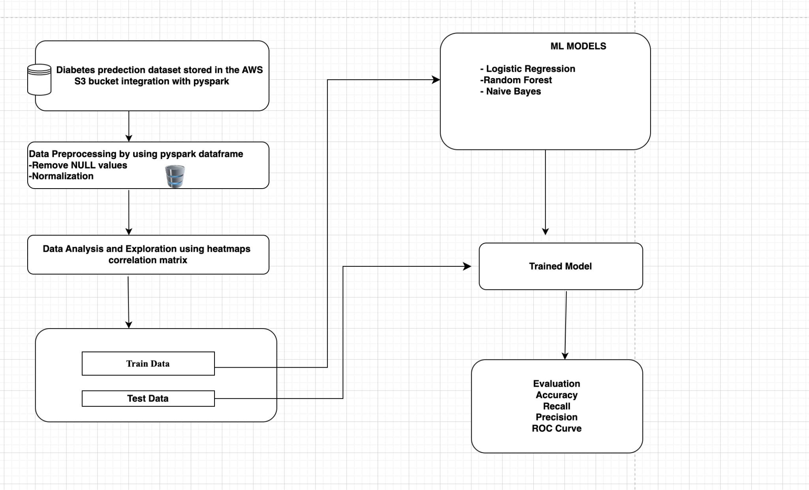
Architecture Diagram
We processed the data by integrating AWS S3 with pyspark and then for data analysis and exploration we are using heatmaps correlation matrix and split the data into train data set and test data set perform ML models on that data evaluate the model by finding accuracy,precision,recall and ROC curve.

Slide 6
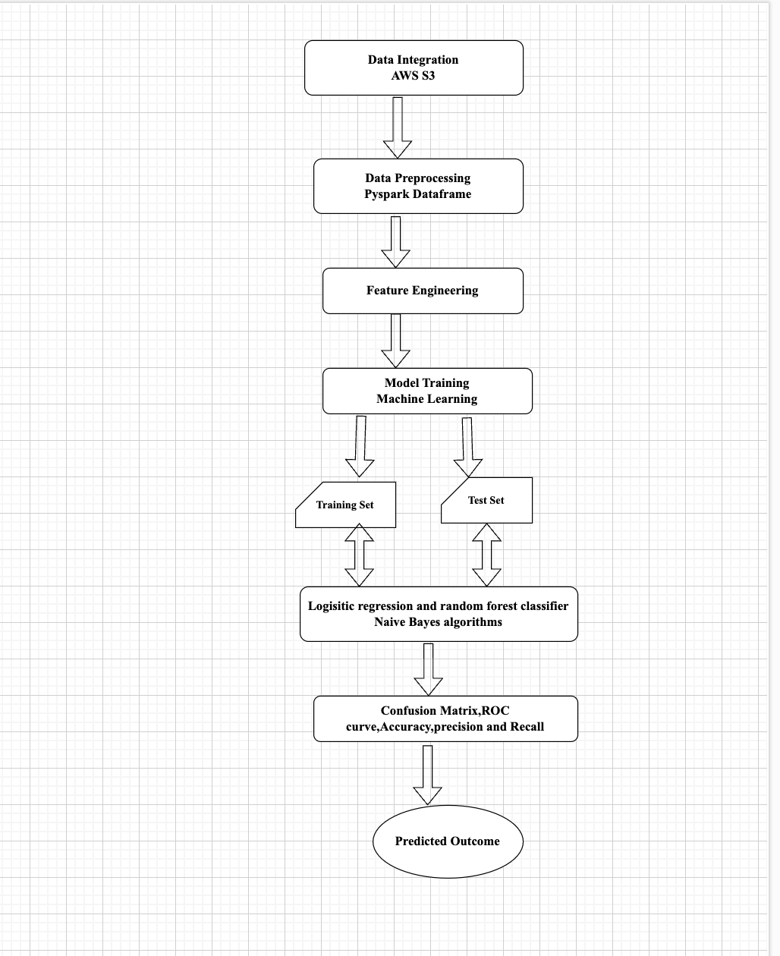
WORKFLOW DIAGRAM FOR DIABETES PREDICTION ANALYSIS

Slide 7
Dataset :
Pregnancies : The amount of births that took place
Glucose: An oral glucose tolerance test was used to assess plasma glucose concentration after two hours of the test. Between 140 and 200 mg/dL, we speak of pre-diabetes or a reduction in blood sugar, while between 200 and 200 mg/dL, we speak of diabetes.
Blood Pressure : The diastolische Blood pressure is measured in mmHg. Values ​​of more than 90 mmHg indicate a high level of blood pressure, which increases the likelihood of developing diabetes, while values ​​of less than 60 mmHg indicate a low level of blood pressure, which reduces the likelihood of developing diabetes.
Skin Thickness : The cut of the triceps skin in mm allows you to determine the body weight. Although the usual height for a woman is 23 mm, obesity and the risk of diabetes increase the assessment.
Insulin : After two hours, the concentration of the Serum rises to mu U/ml. A reading that exceeds the normal level of 16 to 166 mIU/L may be an indication of diabetes.

Slide 8
Dataset :
BMI : The Body-Mass-Index is obtained by dividing the weight in kg by the height in square meters. Between 18.5 and 25 is considered normal, between 25 and 30 as overweight and over 30 as obesity.
Diabetes Pedigree Function : explains the relationship between patients' genetics and their history of diabetes. A high rate indicates an increased risk of developing type 2 disease.
Age : Patients age.
Outcome : Classification variable, which determines whether the subject (1) or (0) has diabetes or not.
Data cleaning aims to eliminate excess empty data. It is designed to replace random variables with Null value, Modes or Media.

Slide 9
Analysis of data :
Data Pre- processing :
Preprocessing : Data for machine learning algorithms is generated in several stages, called Preprocessing. The essential steps in this explanation are as follows:
Handling Null Values : Null values in data collection can be handled both through elimination, appropriate estimations or sophisticated imputation methods, to ensure data completeness.
Handling Duplicate Values : Duplicates are removed to prevent bias and preserve the integrity of the analysis.
Handling Zero Values : We carefully review Zero values to ensure their relevance and accuracy. The situation of useless zero numbers remains the same.
Balancing and Scaling : Normalization or standardization as well as sampling techniques guarantee data homogeneity, which helps improve the performance of machine learning algorithms.
The selection of preprocessing technologies takes into account the requirements of the problems as well as the characteristics of the data. It is crucial to follow all the steps to ensure the accuracy and quality of the machine learning model.

Slide 10
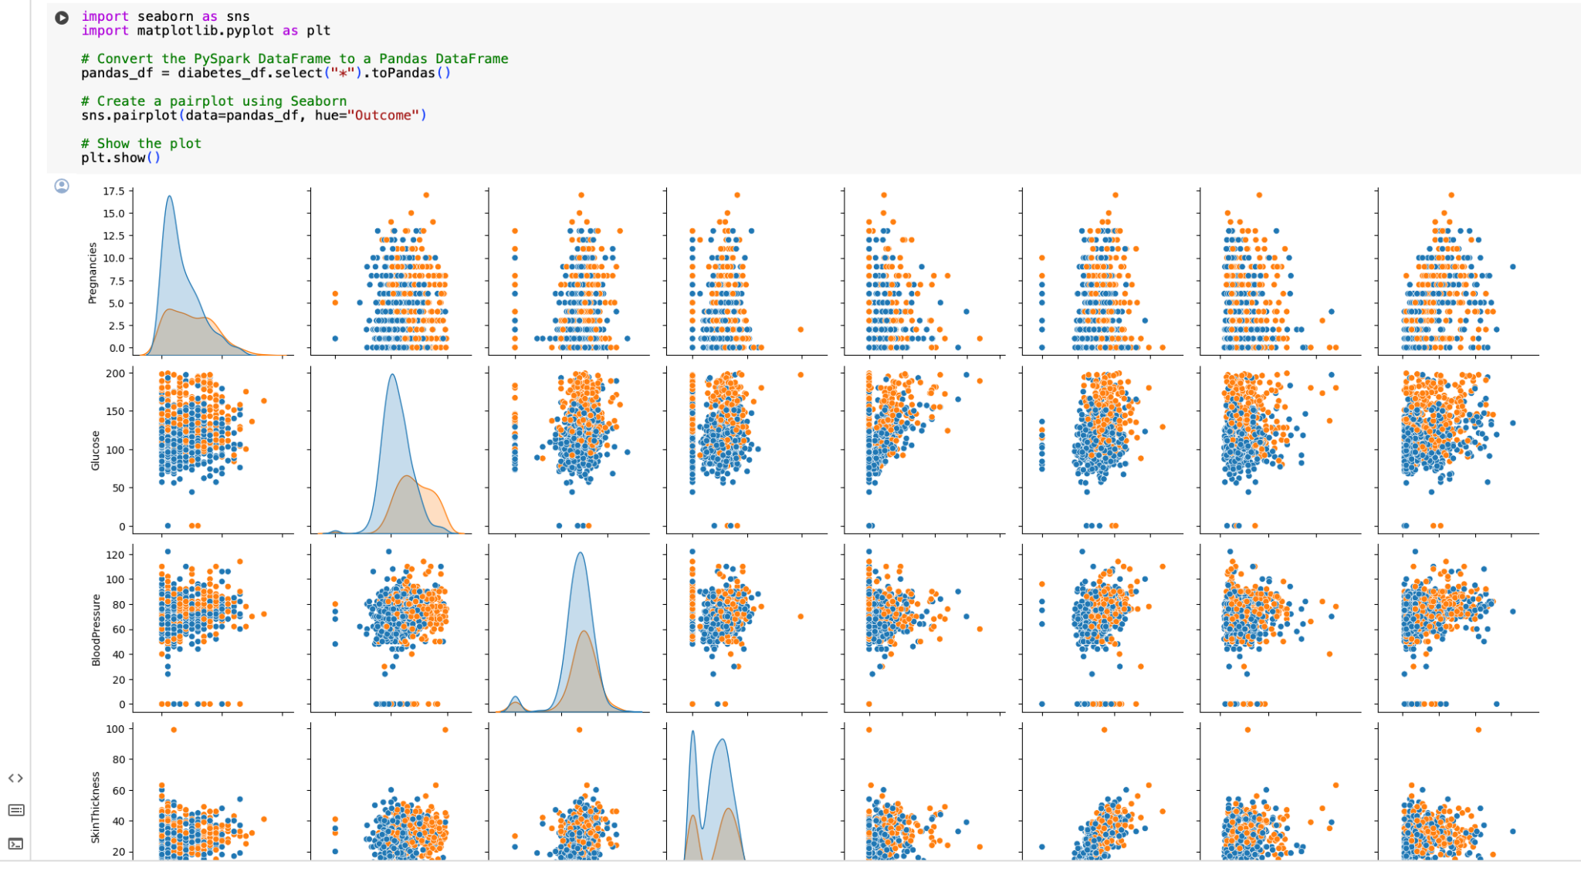
Graph model with explanation :
In the data preprocessing ,for the context of exploratory data analysis (EDA) we are using pairplot to represent the pairwise relationship between the variables in the dataset.
Pairplot is a powerful tool which is used to know the relationship between the variables ,it identifies outliers,correlations and linear relationships between the variables.

Slide 11
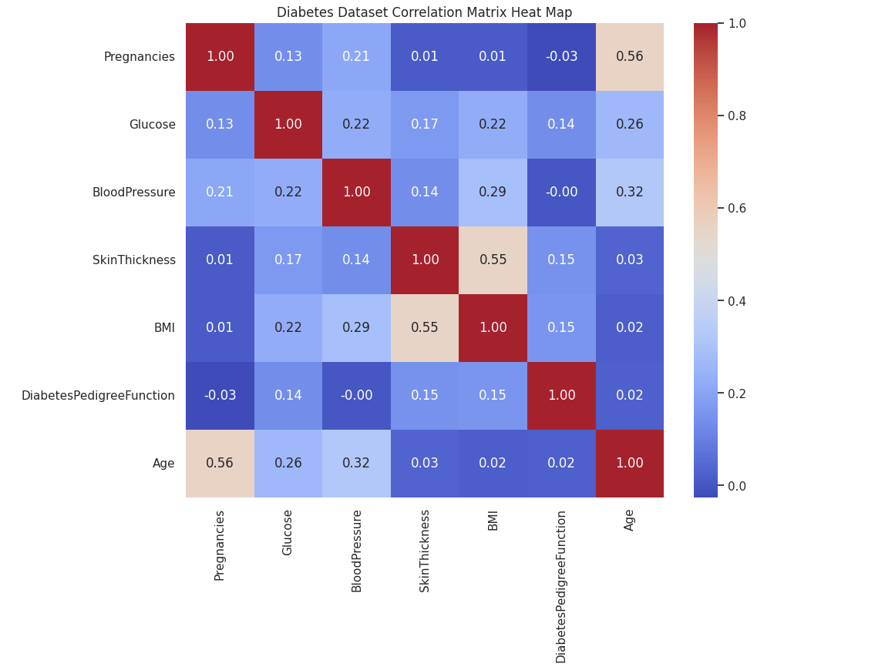
Graph Model With Explanation
Heat maps are used to visualize the exploratory data analysis (EDA).For Diabetes prediction analysis we are using correlation matrix for every Individual attributes.It is used to visualize the correlation matrix of numerical values in a dataset.

Slide 12
Implementation :
Managing and analyzing a diabetes database located in an AWS S3 bucket using PySpark. A Spark session is configured with the JAR files needed for the AWS integration after reading the diabetes dataset directly from S3. Solving problems with large numbers and summary statistics, as well as solving problems with missing and duplicate values, are all requirements when it comes to preparing data.The data has been cleaned to remove null values Either the records are removed or relevant statistics, such as medians, are added instead. To convert the suitable columns into a suitable vector for machine learning algorithms, the feature engineering method is used. In the next step, post-collection is used to balance the data and find connections to resolve class imbalances.The model is trained and evaluated with a Spark ML logistic regression classifier. To be precise, the F1 scores and ROC-AUCs are used to evaluate the model after dividing the data into training and testing subsets. In addition, a confusion matrix is ​​used to show predictions in order to obtain information about the capacity of the classifier. Finally, the model calculates and displays the regression logistics parameters. This emphasizes how easily it is interpreted by artificial intelligence.

Slide 13
Algorithms :
Logistic Regression:
Type: Supervised learning
Use Case: Predict bilinear results based on single variables. This is used to detect diabetes.
Working Principle: A logistic regression uses a logical function, or an S-shaped curve, to estimate probabilities. This function transforms any real number into a value that is suitable for binary classification.
Evaluation: F1 score, recall, precision, precision and area under the ROC curve (AUC-ROC) are used to evaluate its performance. These measures evaluate the model's ability to classify positive and negative classes, balancing the rate of incorrect and accurate predictions.
Random Forest :
Type: Supervised learning
Use Case: Works well with larger, more complex databases.
Working Principle: During training, several decision trees are created, and the class that emerges is the average of these trees. Accuracy is improved when unpredictability is added to the model during the tree building process.
Evaluation: It is based on ensembles, precision and other factors are similar to logistic regression; However, because it is ensemble-based, there is less variation and bias.

Slide 14
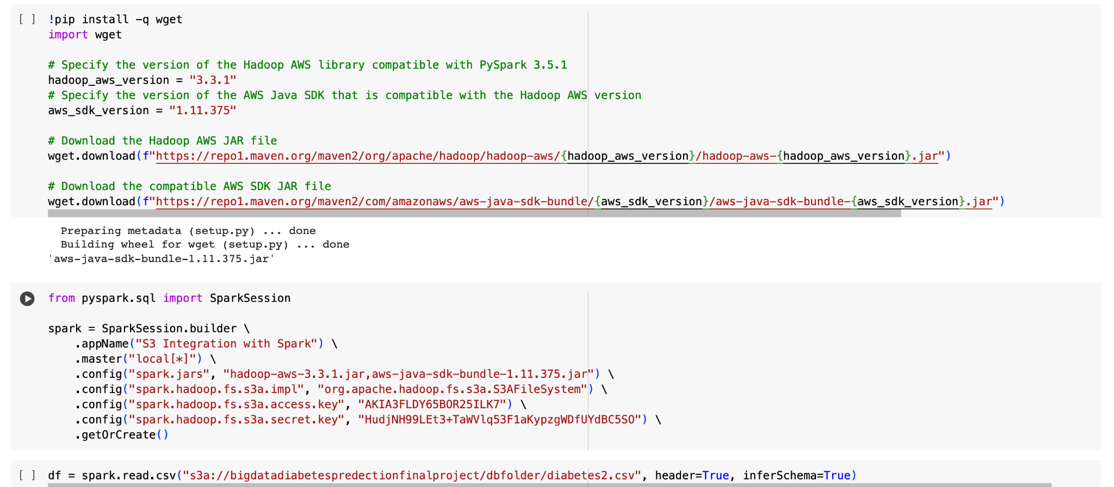
Integration of pyspark with AWS S3
In our project we are Integrating AWS S3 with pyspark.we have created a S3 bucket and stored the dataset into it.It will store the data in the form of hdfs file system. we are Integrating that data with pyspark and predict the diabetes for a human.

Slide 15
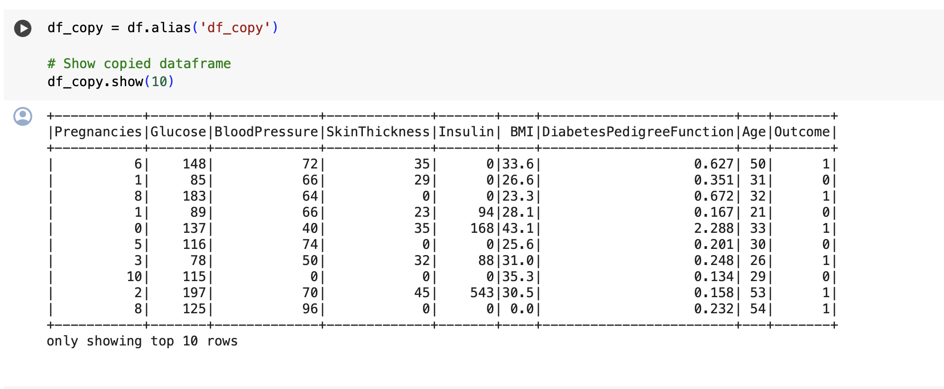
Explanation of Implementation:
Display the data from the dataset.

Slide 16
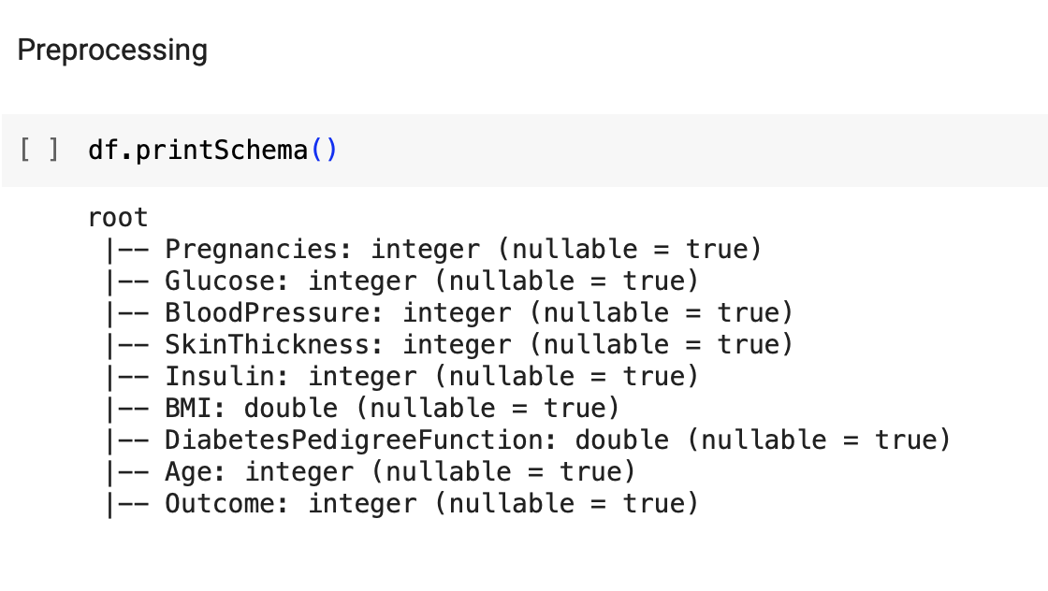
Preprocessing:
Preprocessing step Involves :
Handling Null values
Handling Duplicate Values
Handling Zero values
Balancing and Scaling

Slide 17
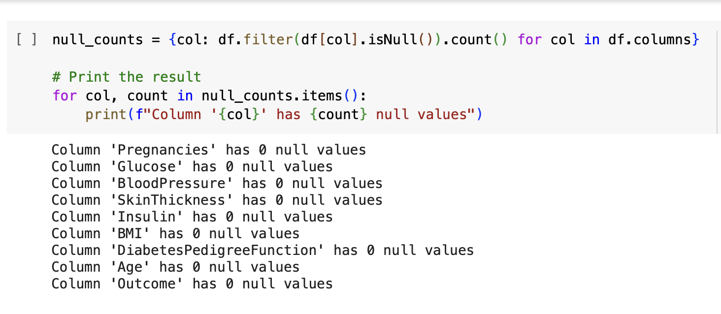
Handling Null values
Here we are extracting null values from the diabetes prediction dataset as it does not contain any null values it gives the output there is no null values.

Slide 18
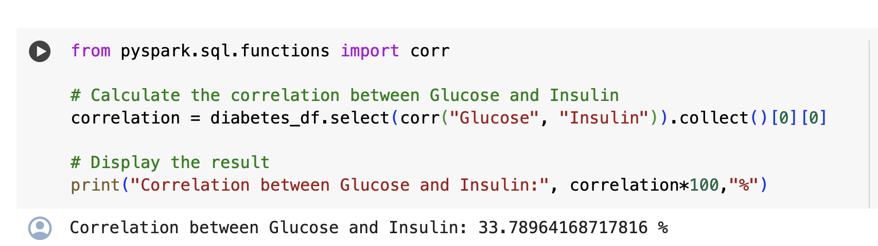
Find Correlation between Glucose and Insulin

Slide 19
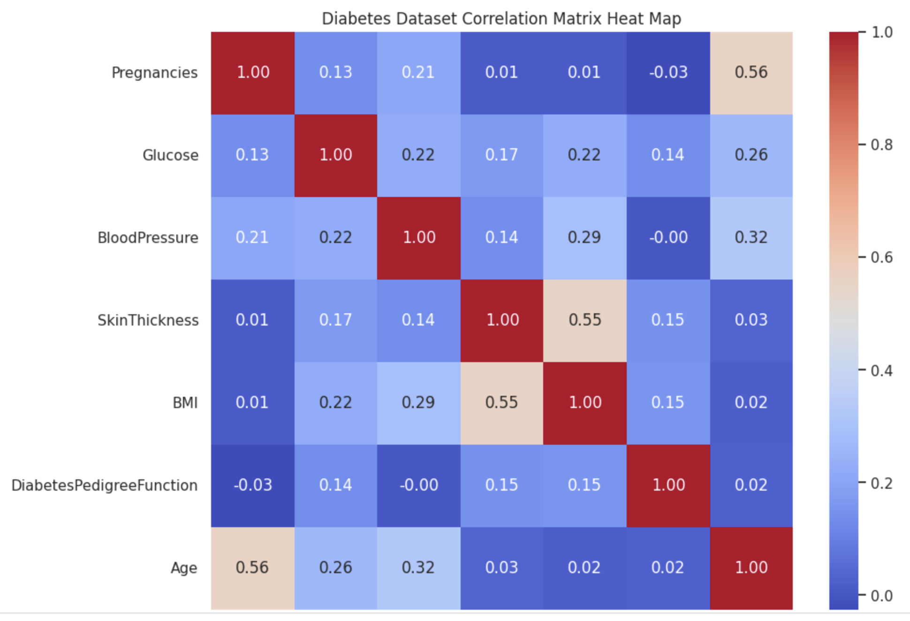
Implementation of Correlation Matrix of Independent attributes by using the heatmap.

Slide 20
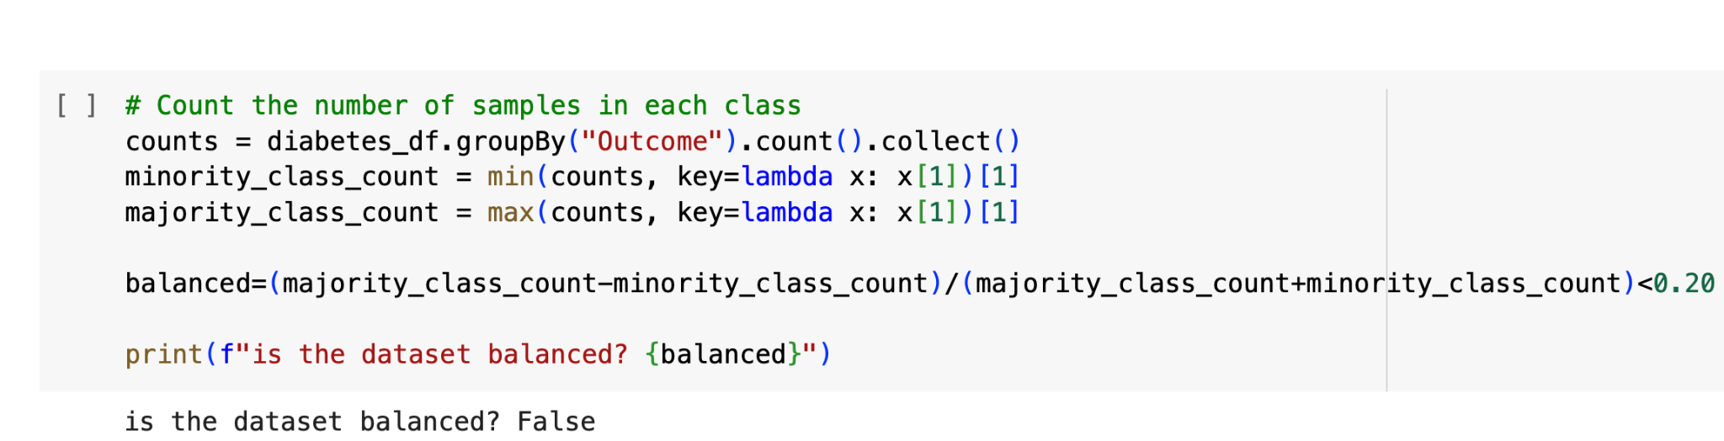
Checking the balance
Outcome, which indicates whether or not a person has diabetes, is the target variable in our dataset. The target variable does not have a reasonably acceptable balance between the two kinds of values.
The difference between the most and least repeated labels is calculated, divided by the entire data, and used to determine whether the target variable is balanced. If this ratio is less than 20%, our data is considered balanced.

Slide 21
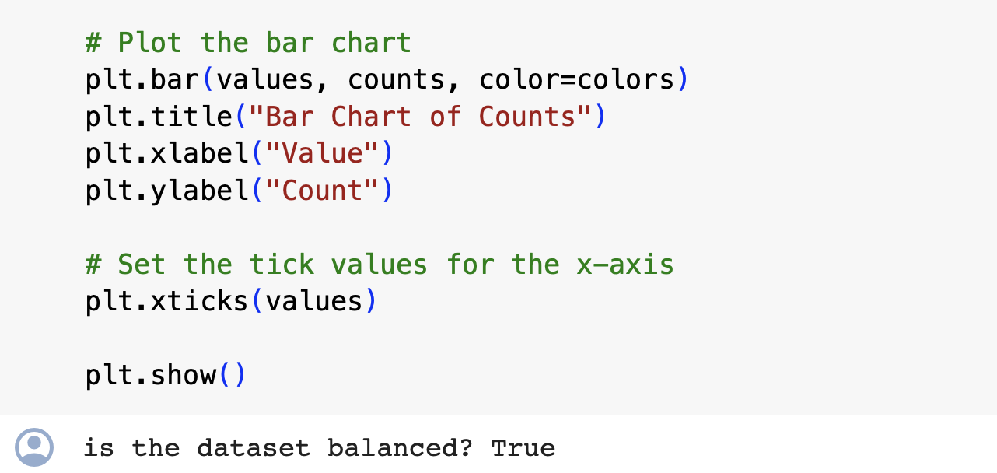
Fixing the unbalanced data
We must deal with this issue because the dataset is skewed. Using a sampling approach is one appropriate solution to this issue.
This approach involves extracting all of the label data that has fewer repetitions and adding a portion of the label data that has more repetitions. The extracted data will be well-balanced and aid in resolving the imbalance problem in the original dataset.

Slide 22
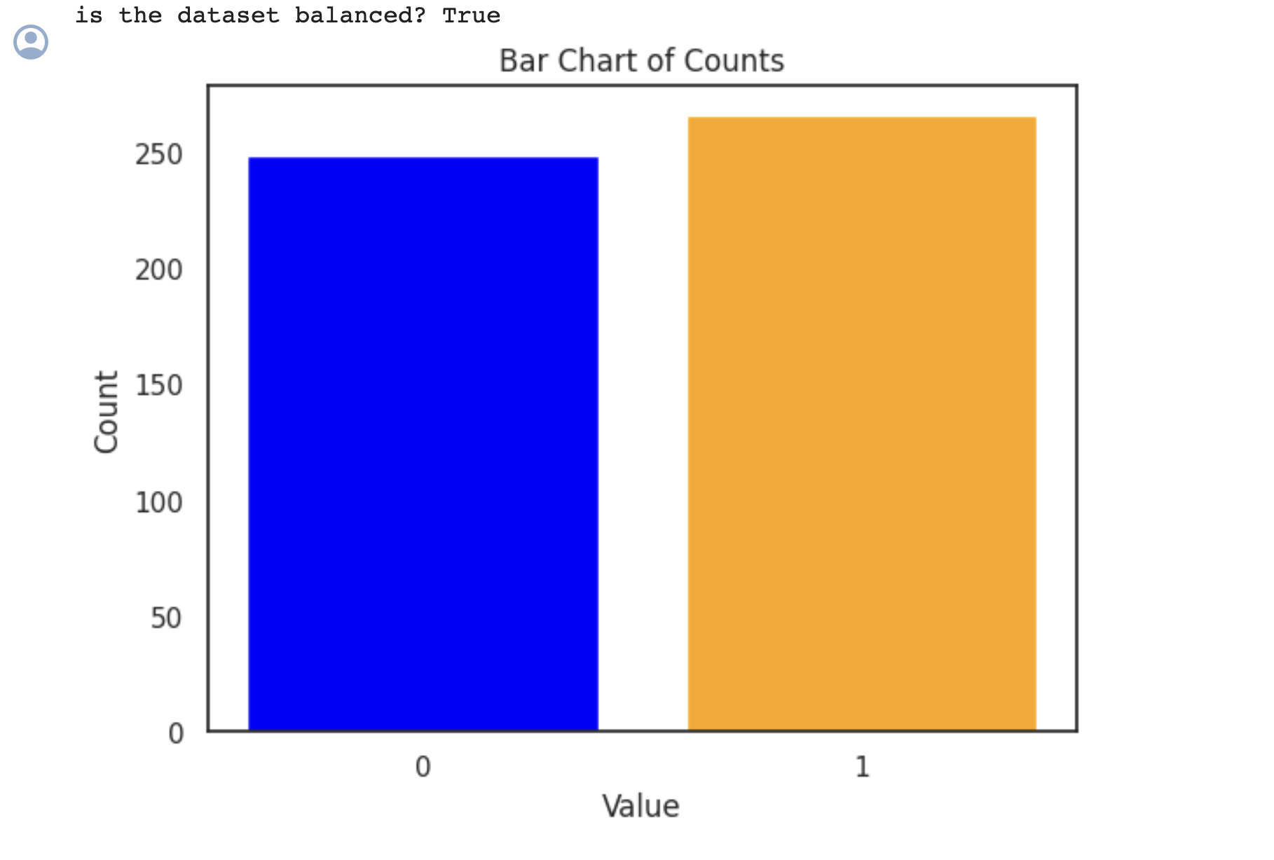
Bar Chart Representation

Slide 23
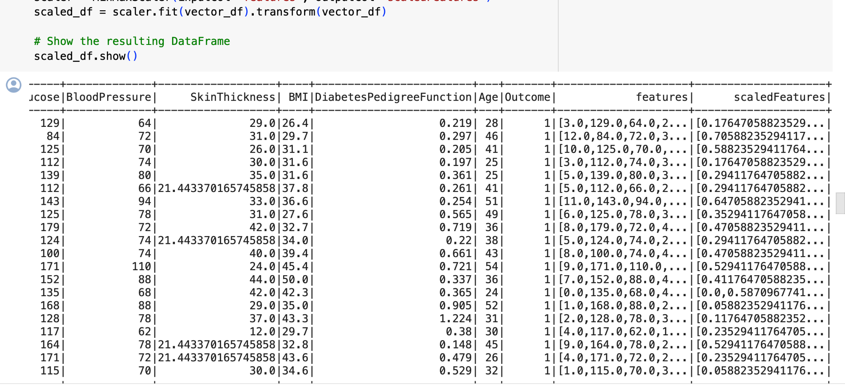
Scaling Features:
The last stage of pre-production is functionalization. The minimum and maximum values ​​for each attribute determine the adjustment of this scale. The minimum and maximum values ​​of the function are used to align the entire data to the interval of 0 to 1.
It is essential to follow this process during the learning process to ensure that this or that function is not preferred due to its wide use. It can also contribute to the standardization of training algorithms and to the improvement of the resistance of Models to different dimensions of data.

Slide 24
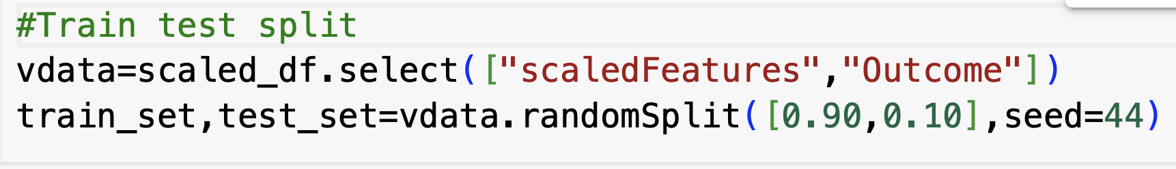
Learning
This is a split of training and testing data. Tests are given to the Model, and test performance is evaluated based on the tests.
Model fitting to training data: We use an appropriate method to train the Models on the training system.
Analyzing the model's performance using test data: The model's performance is assessed on the test set by using suitable evaluation measures, including accuracy, precision, recall, or F1 score.

Slide 25
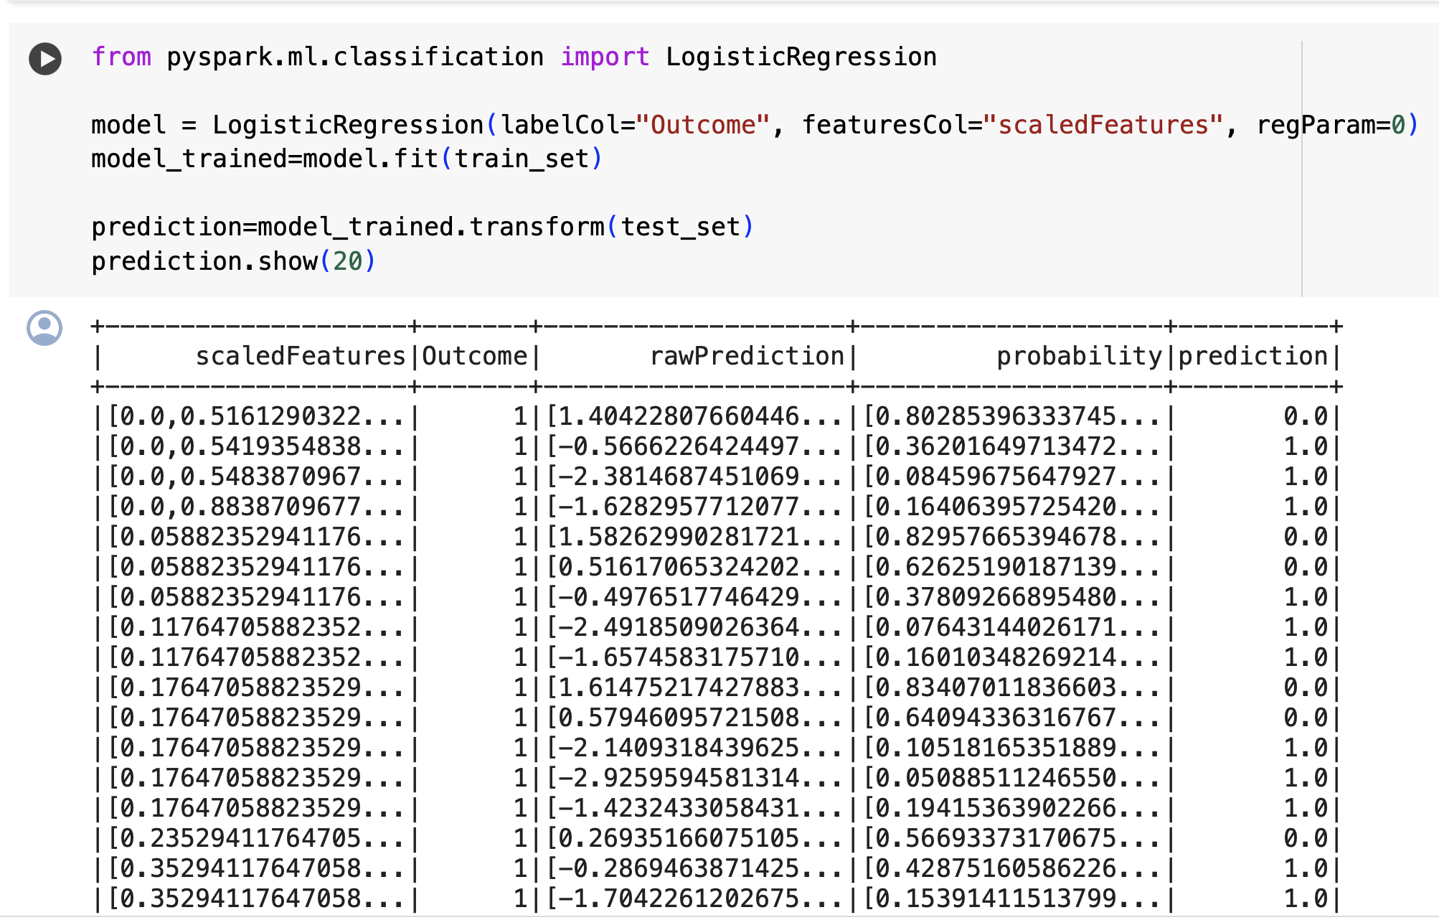
Fitting the Model
Fitting the model to the training data is the next stage of the learning process, which involves dividing the data into training and test sets. In order to do this, choose a suitable algorithm or model and train it on the training set.

Slide 26
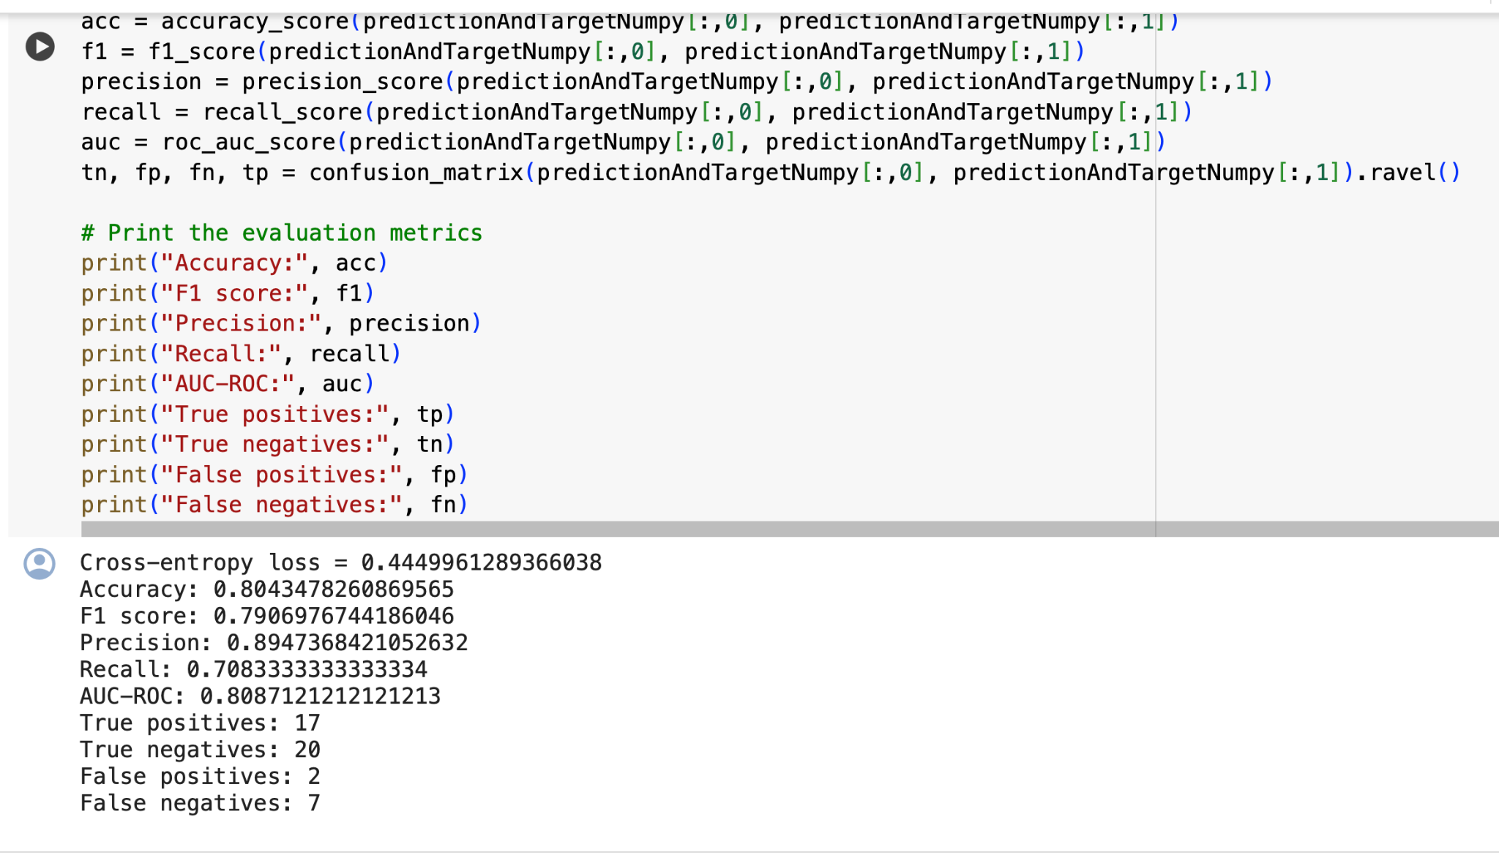
Evaluation
Once the learning process is over, it's critical to assess how well the model performs with fresh, untested data.
Numerous evaluation metrics, including accuracy, precision, recall, F1 score, ROC curve, and AUC score, have been created for two-class classification models. These metrics are useful for evaluating various models and determining which is best for a particular issue.

Slide 27
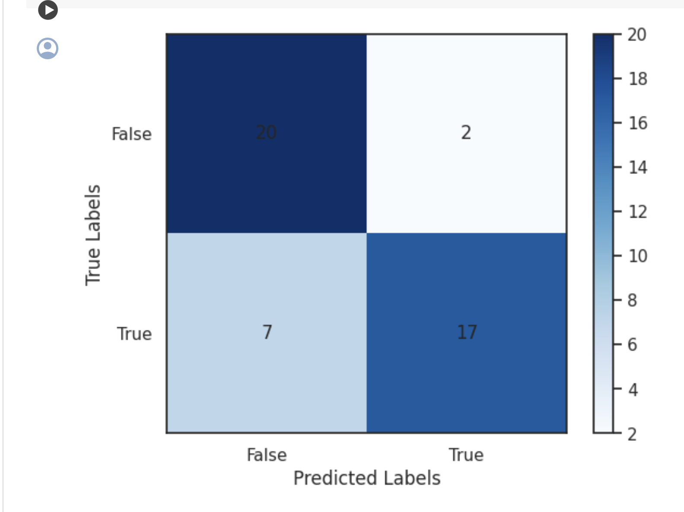
Confusion Matrix
A table that defines a classification algorithm's performance is called a confusion matrix. An method for classifying objects can be seen and its performance summarized using a confusion matrix.

Slide 28
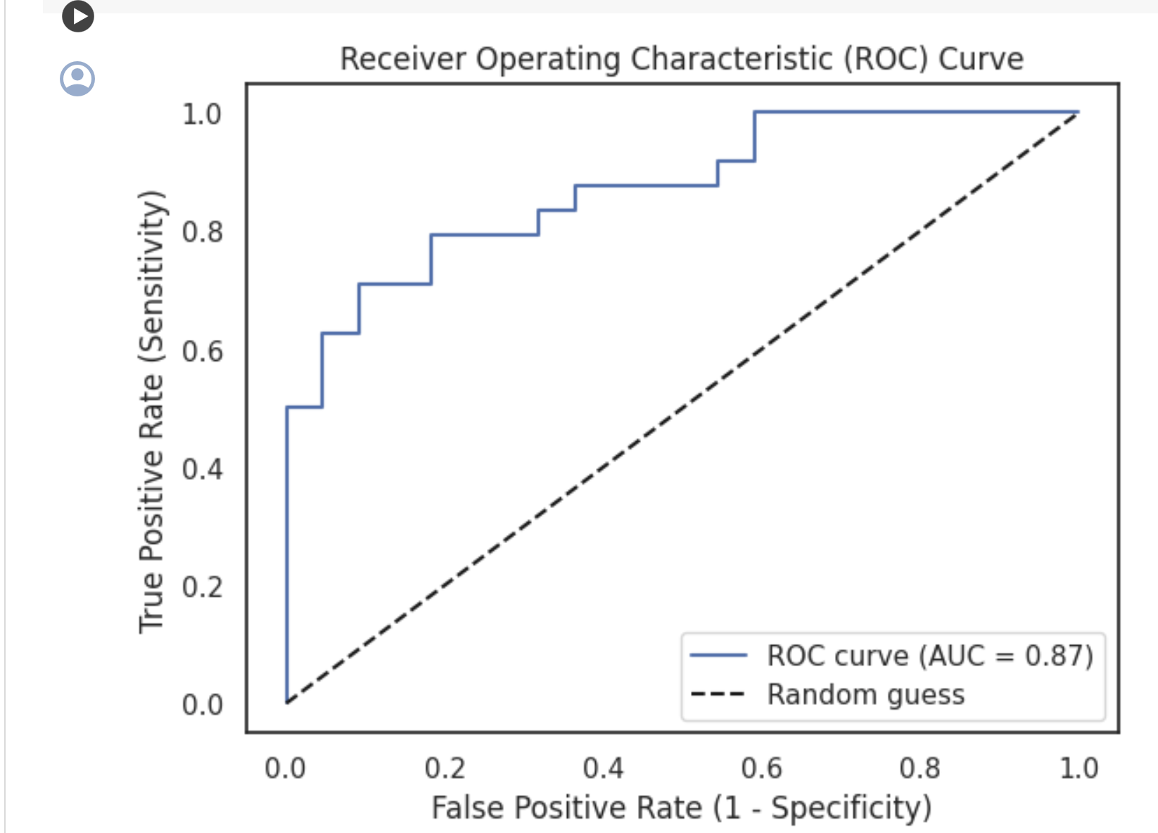
ROC Curve:
A graph that displays a classification model performance overall classification thresholds is called a receiver operating characteristic curve, or ROC curve. This curve displays two variables: Real Positive Percentage. false positive percentage.

Slide 29
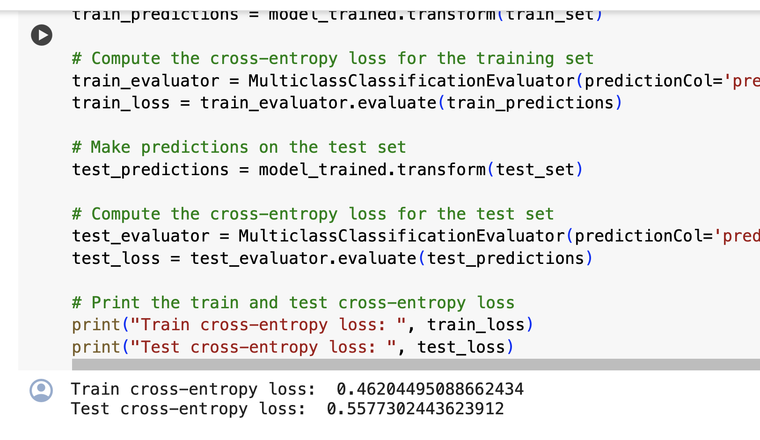
Comparing Test and Train Errors:

Slide 30
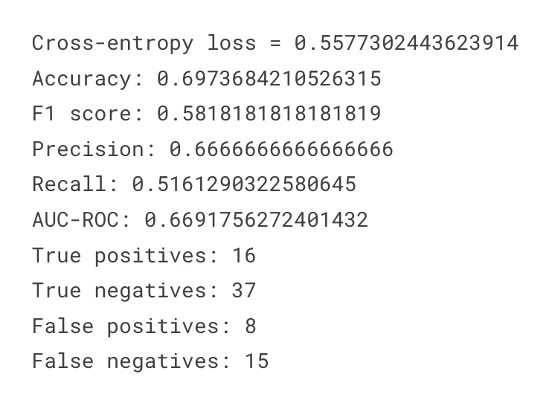
Evaluation of Preprocessing Data:
During this stage, the preprocessed copy of the data is used to assess how well the preprocessing went. The model performs much better after preprocessing, as evidenced by a comparison of the evaluation metrics of the model trained on preprocessed data with the model trained on non-preprocessed data.

Slide 31
Conclusion:
In this evaluation, we used PySpark integration with AWS S3 to design a more efficient and flexible diabetes detection model. A highly accurate prediction model was developed using preprocessed data and methods. It is emphasized that glucose and body weight (BMI) play a crucial role. Through the integration of AWS S3 with PySpark, it is possible to easily carry out data management and analysis, which results in a costly solution. A thorough study and analysis of data sources could improve the application and accuracy of the models. Data-driven methods for early identification of diabetes improve health and medical outcomes.

Slide 32
Project Management:
Team Member 1 : Swapna Sonti
Description: Design and Implementation of Data Integration with Pyspark and S3 and PPT preparation.
Contribution: Analysis,Integration,preprocessing of data and Exploratory Data Analysis.(25%)
Team Member 2: Keerthi Annem
Description: Implementation of ML models(Logistic regression)
Contribution: Implemented ML algorithms and PPT preparation (25%)
Team Member 3: Rajasekhar Ponnuru
Description: Designed Architecture diagram and visualizations
Contributions : Implemented and designed visualizations (25%)
Team Member 4: Pavan Kalyan Ganta
Description : Develop Machine Learning model and train the data(random Forest )
Contributions: Implemented Machine Learning algorithms and train the data (25%)

Slide 33
References/Bibliography:
https://www.kaggle.com/code/soheiltehranipour/pyspark-eda-diabetes-dataset.
https://www.youtube.com/watch?v=S-u1dQLmttc
https://github.com/revaan-mishra/Diabetes_Prediction
https://www.kaggle.com/code/ahmetcankaraolan/diabetes-prediction-using-machine-learning
https://data.world/informatics-edu/diabetes-prediction

Slide 34
THANK YOU!!

